Slide 1
Actuarial Association of Europe

Slide 2
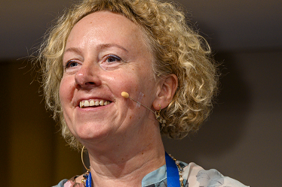
Actuarial Association of Europe
The Actuarial Association of Europe (AAE) was established in 1978 under the name Groupe Consultatif to represent actuarial associations in Europe. Its purpose is to provide advice and opinions to the various organisations of the European Union – the Commission, the Council of Ministers, the European Parliament, EIOPA and their various committees – on actuarial issues in European legislation.
The AAE currently has 38 member associations in 37 European countries, representing nearly 30,000 actuaries.
Advice and comments provided by the AAE on behalf of the European actuarial profession are totally independent of industry interests.
Inga Helmane, AAE Chairperson

Slide 3

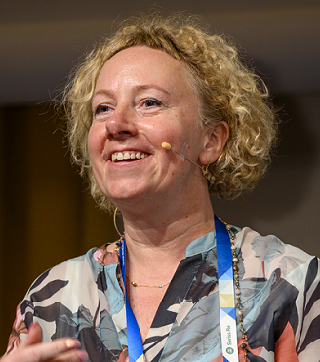

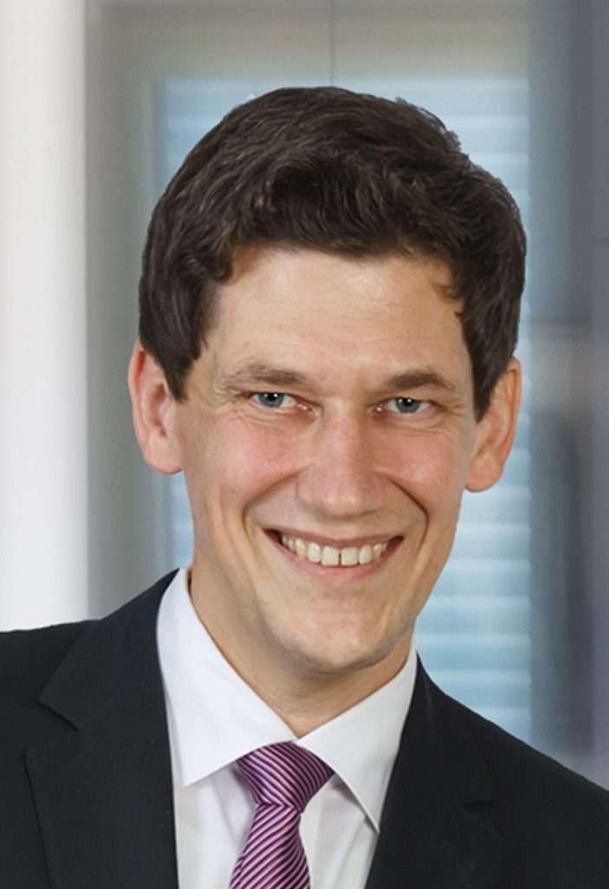
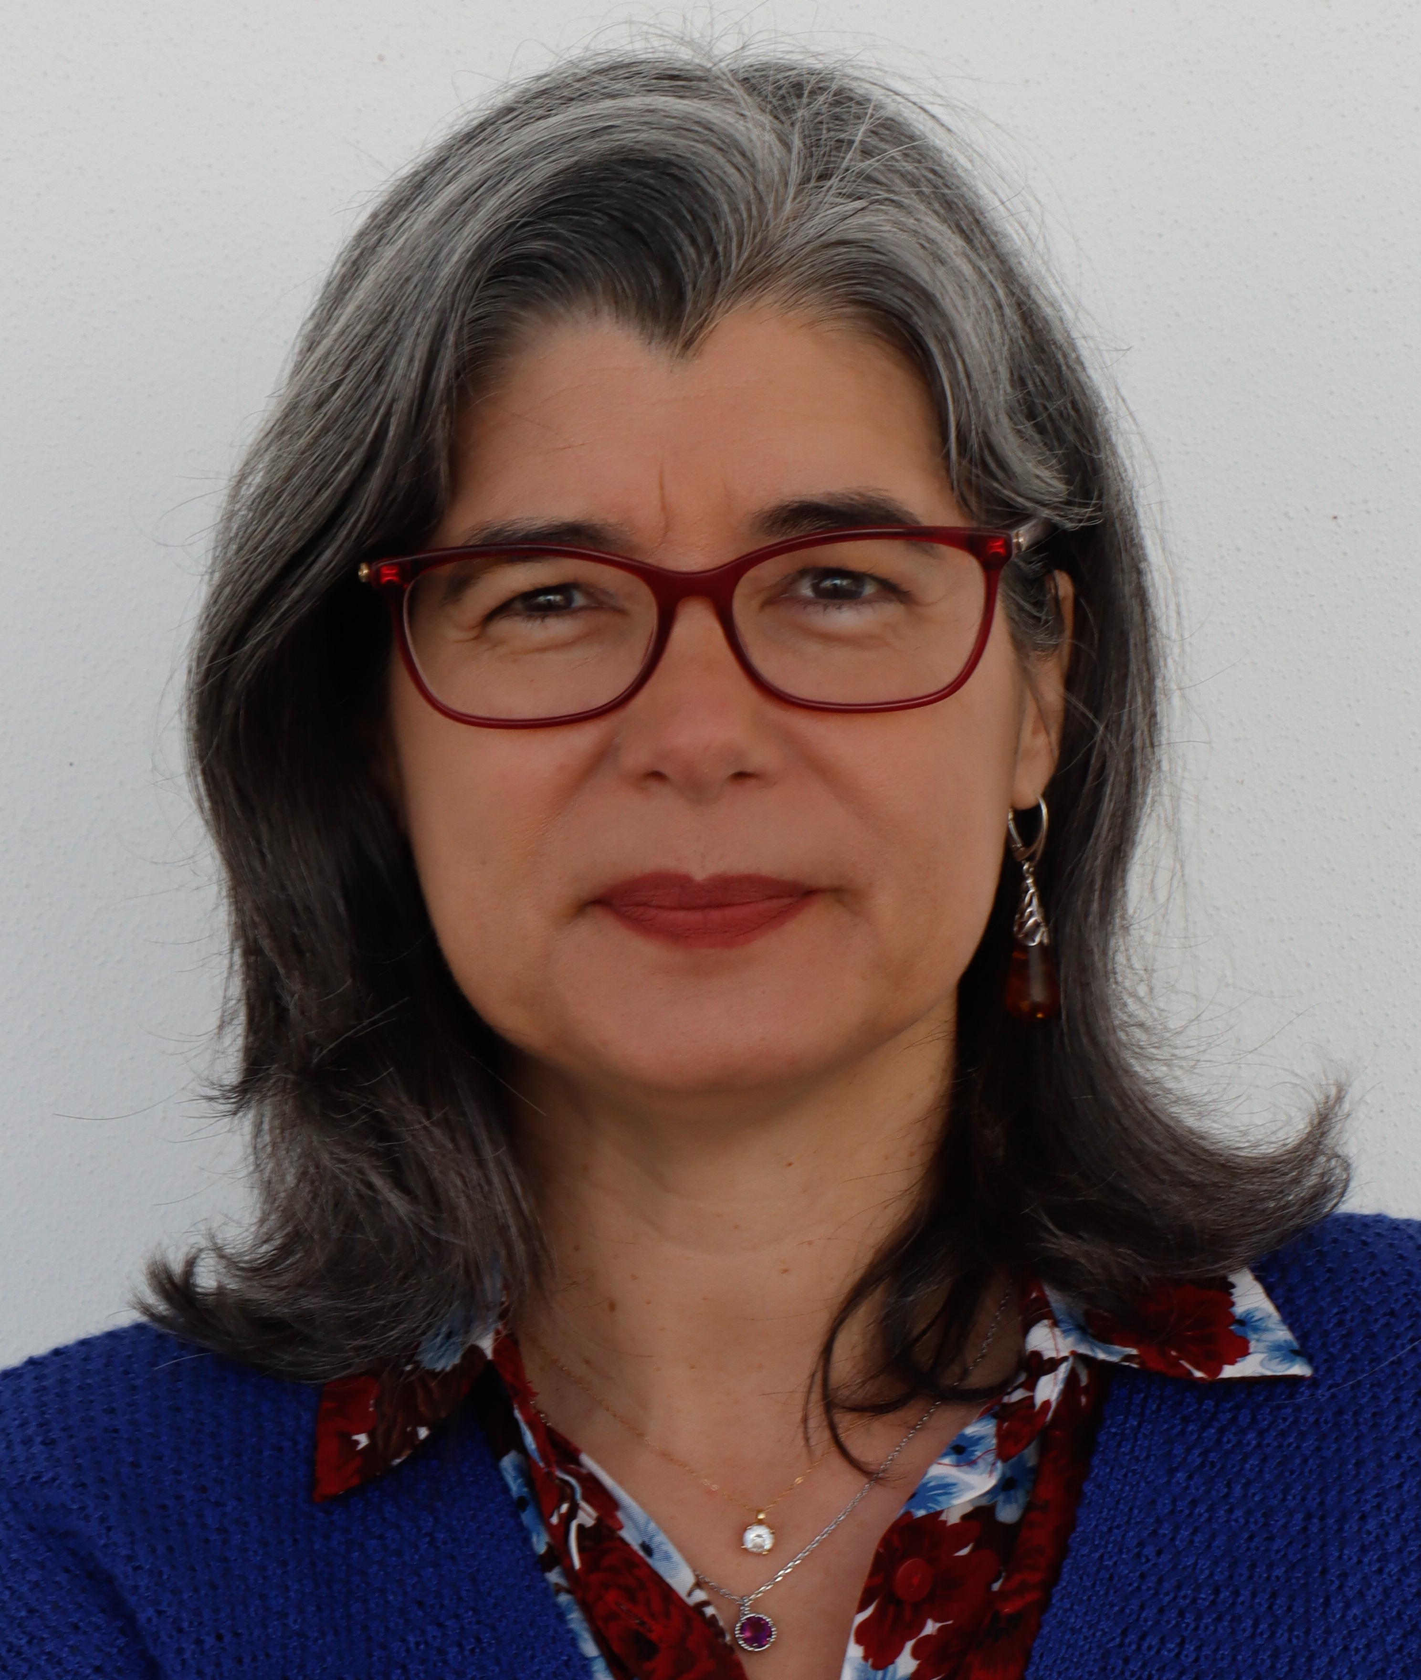
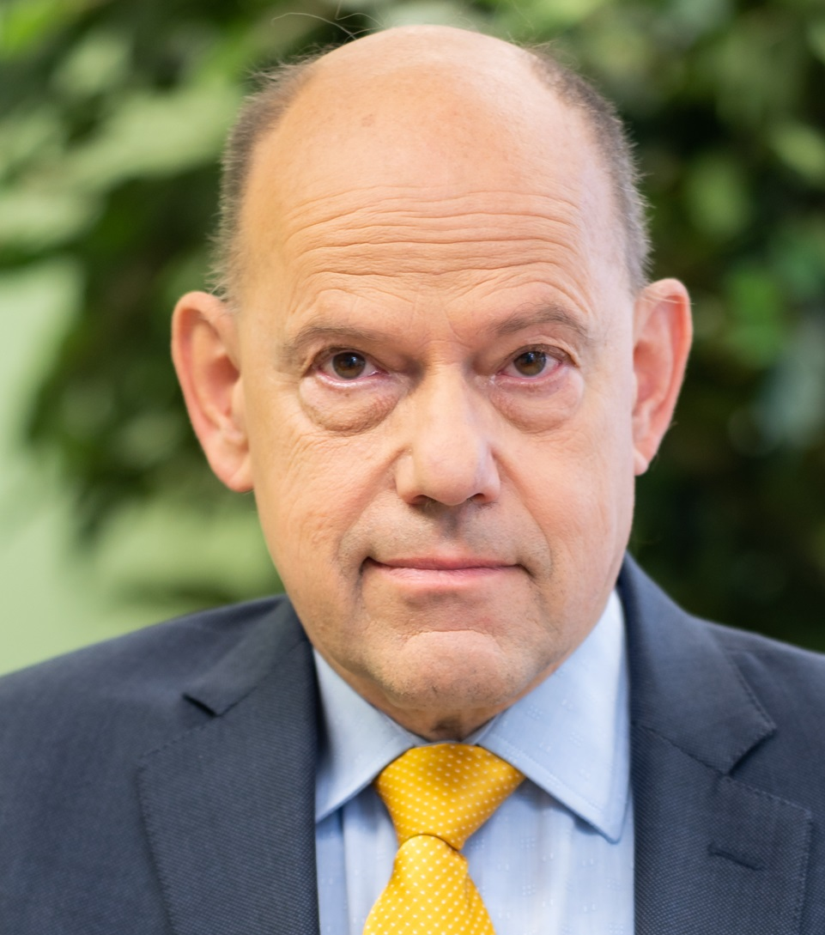
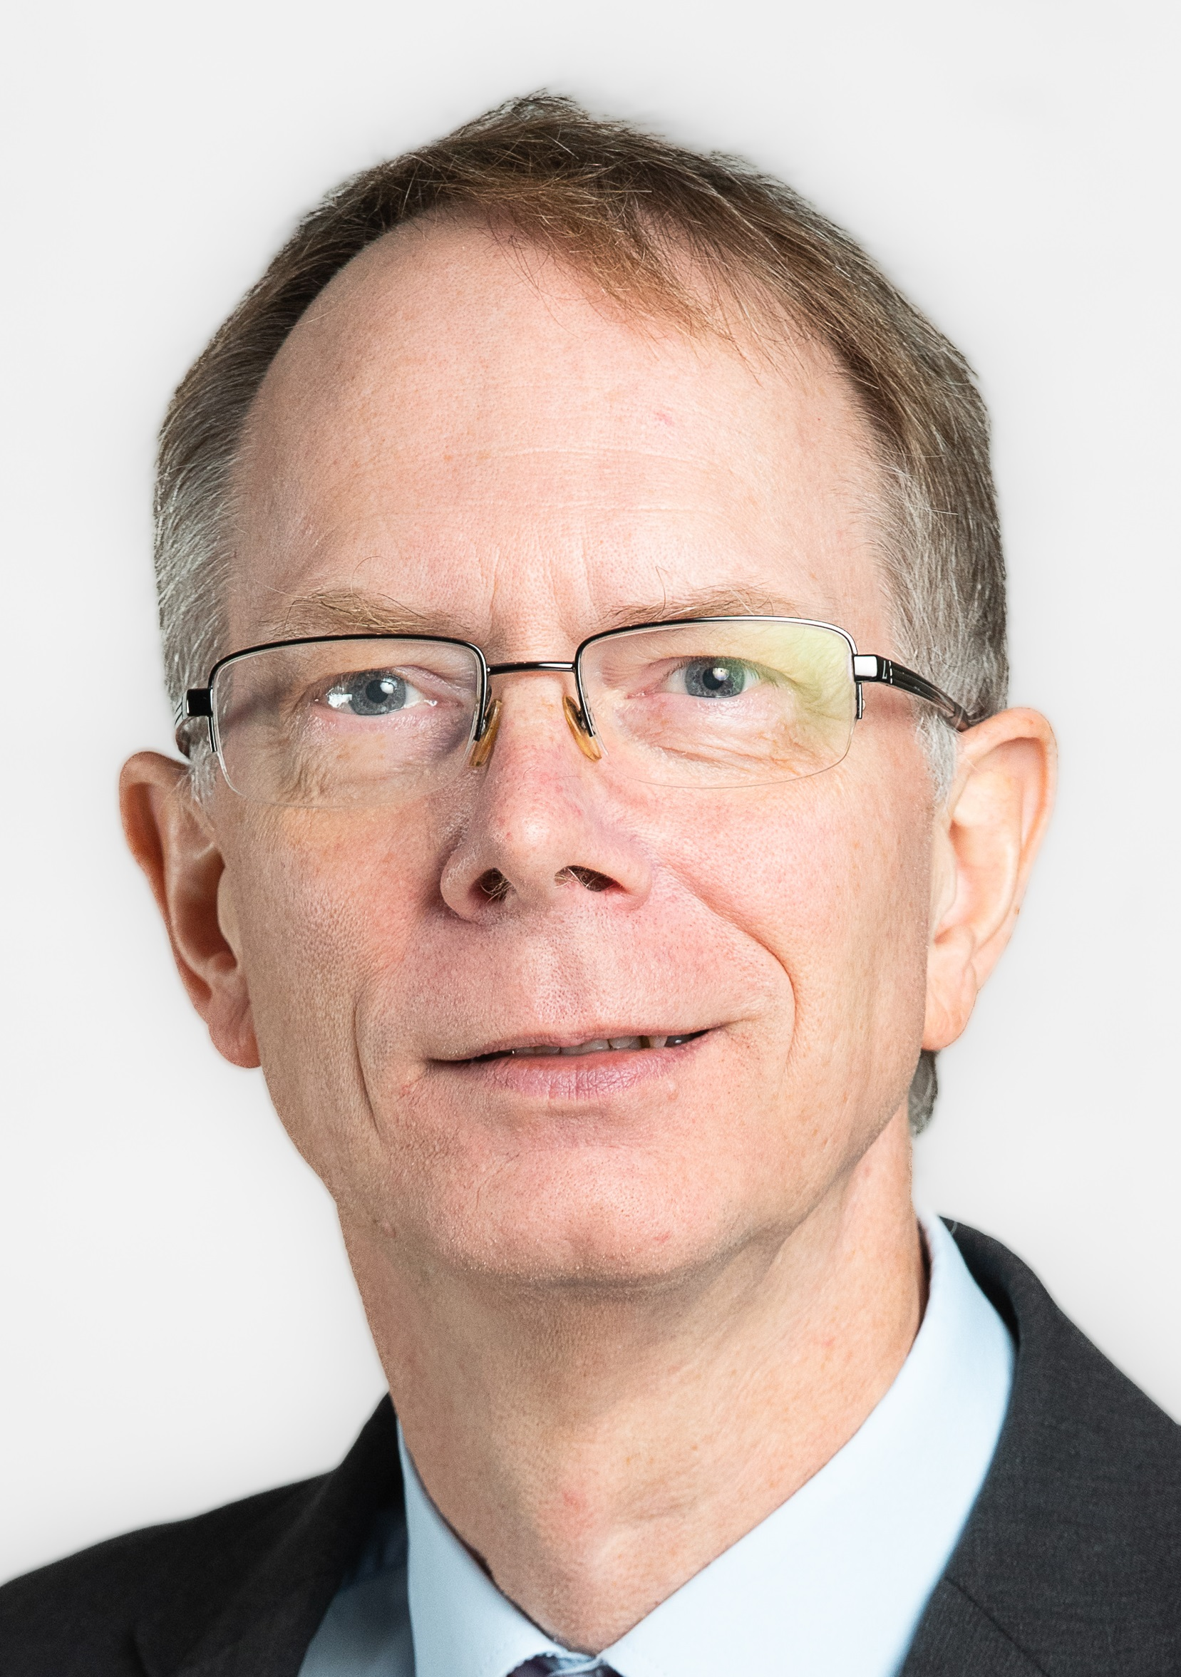
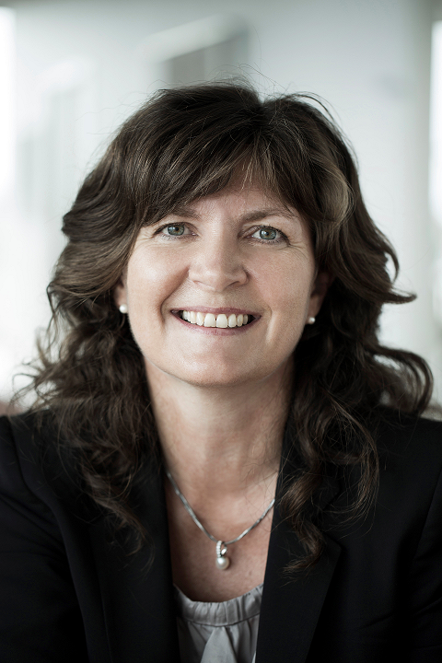
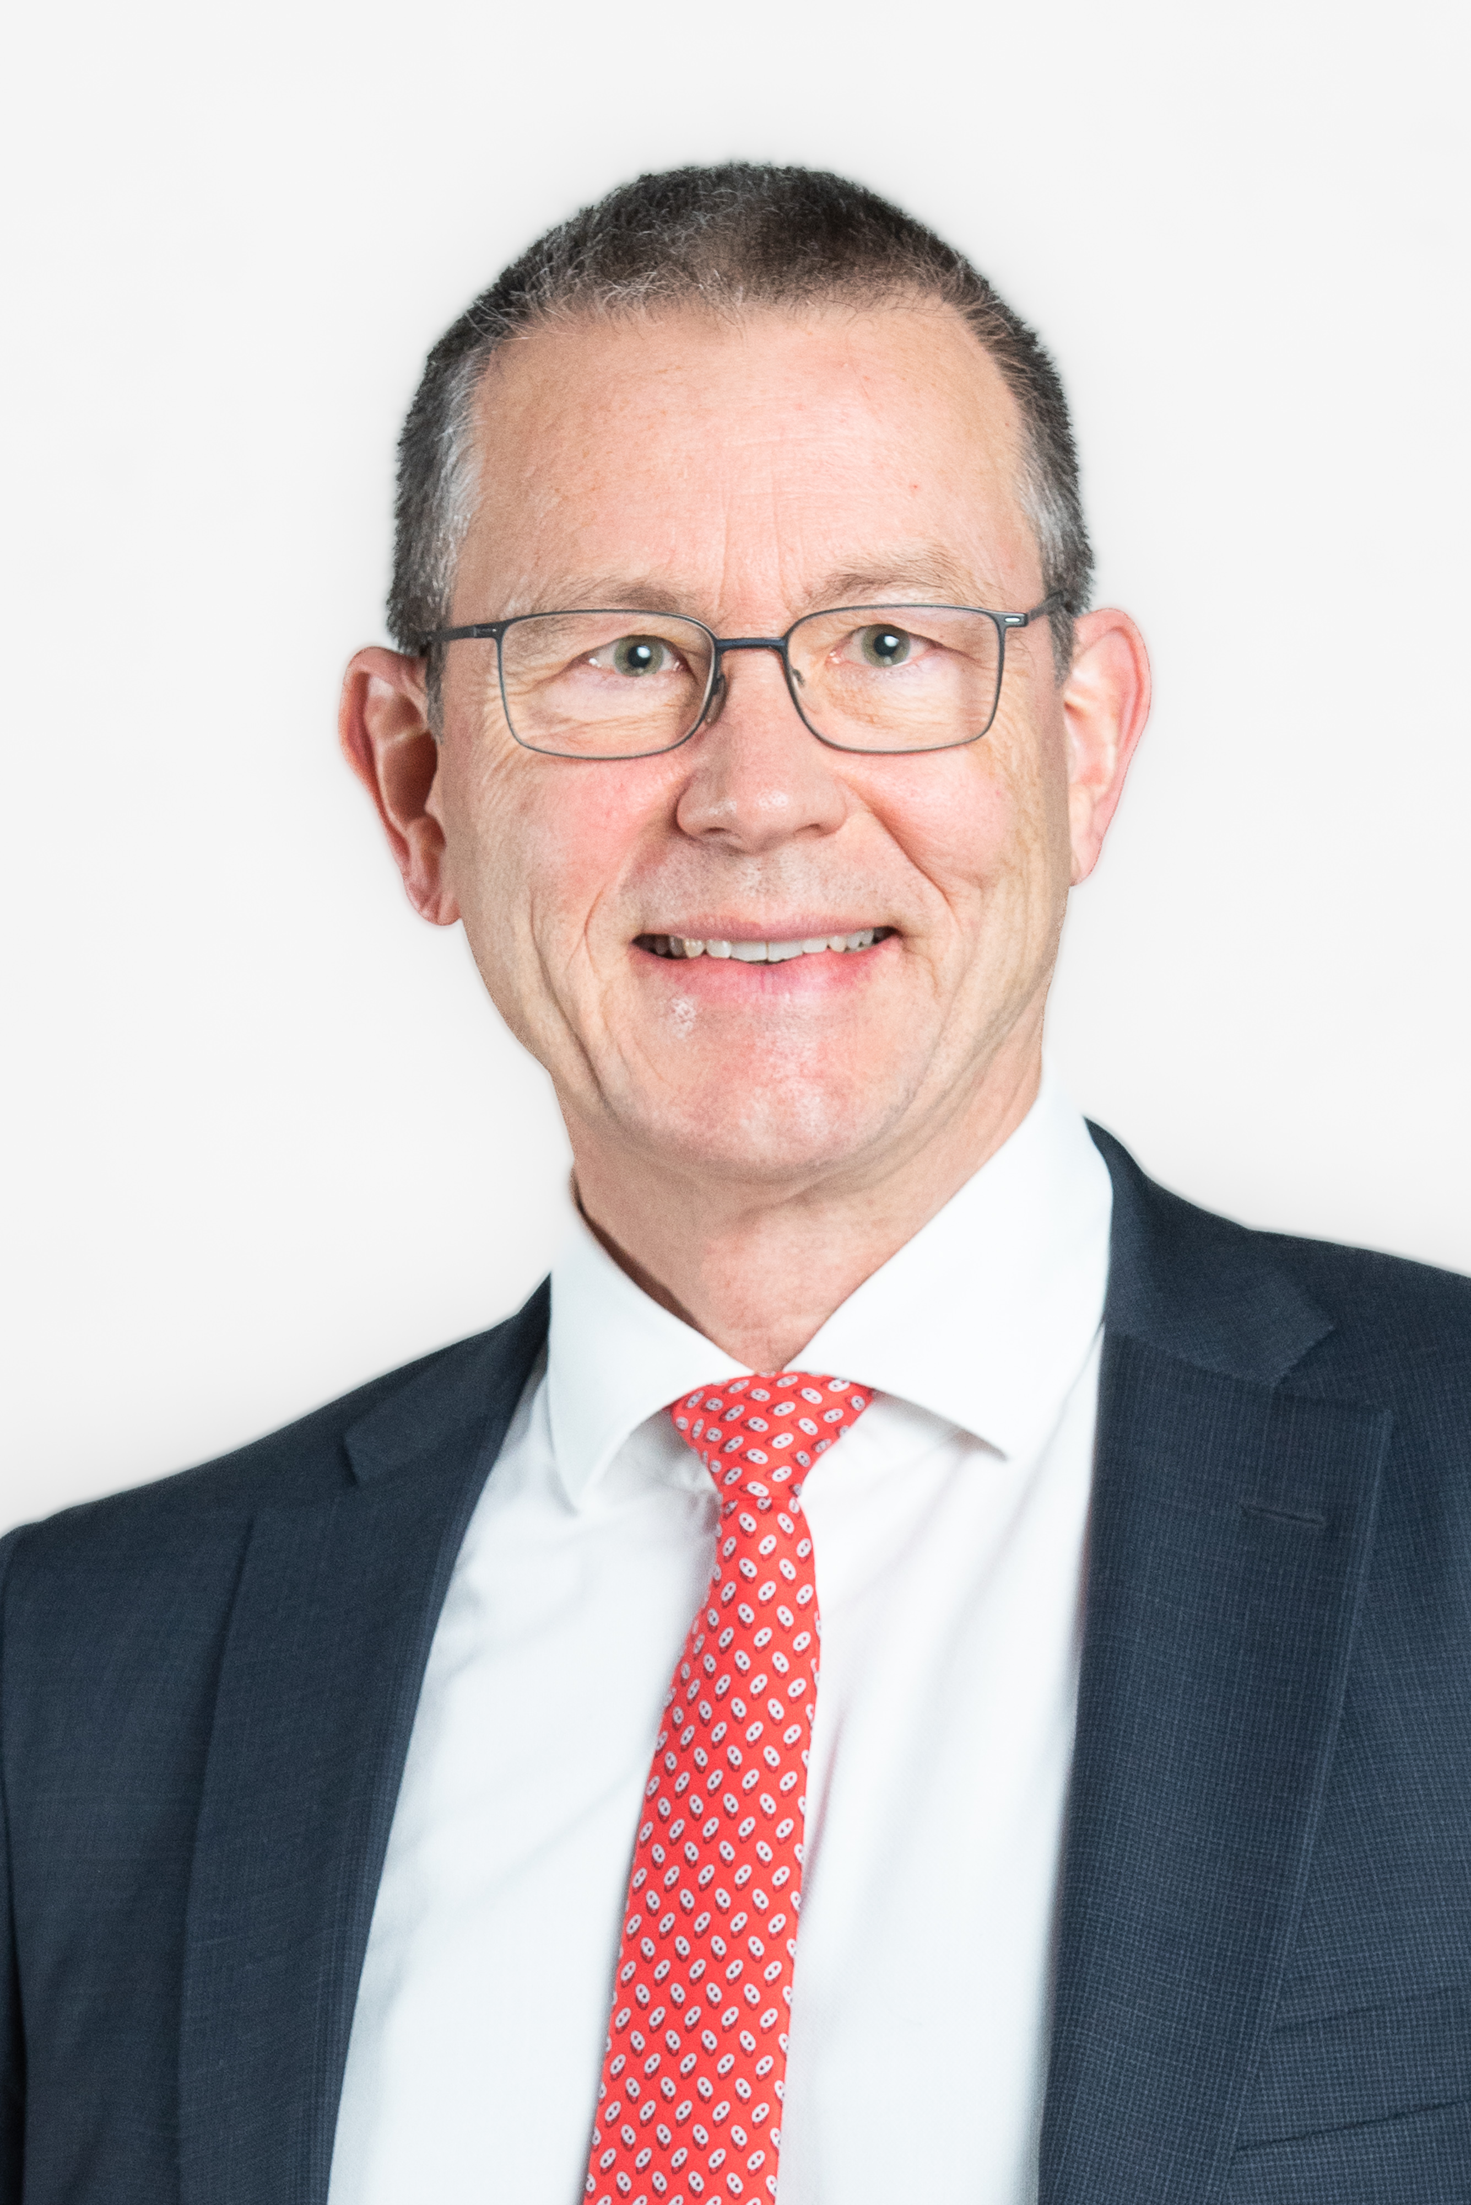
Board of Directors
Immediate Past Chairperson
Lutz Wilhelmy (Switzerland) Elected July 2024
until GA 2025
Chairperson
Inga Helmane (Latvia)
Elected July 2024
until GA 2025
Vice-Chairperson
Matthias Pillaudin (France)
Elected July 2024
until GA 2025
Board member
Frank Schiller (Germany)
Elected October 2022 for 3 years
Board member
Lourdes Afonso (Portugal)
Elected October 2023 for 3 years
Board member
Hartwig Sorger (Austria)
Elected October 2023 for 3 years
Board member
Malcolm Kemp (UK)
Elected October 2023 for 2 years
Board member
Jette Lunding Sandqvist (Denmark)
Elected October 2024 for 3 years
Board member
Philippe Demol (Belgium)
Elected July 2024 until GA 2027

Slide 4
AAE Strategic Objectives and Key Pillars
Strategic Objectives Vision statement
1
  The vision of the AAE is for actuaries throughout Europe to be recognised as the leading quantitative professional advisers in financial services, risk management and social protection, contributing to the well‐being of society, and for European institutions to recognise the valuable role that the AAE plays as a leading source of advice on actuarial and related issues.
Enhance Relations with European Institutions
2
Promote Professionalism
3
Promote a European Community of Actuaries
Key Pillars
Development of the Actuarial Profession in traditional areas and wider fields
Communication and Stakeholder Relationship Management
Lifelong Learning and Exchange of Ideas
Setting Guidance and Standards
for the Actuarial Profession
AAE Operations and Governance
1
2
3
4
5

Slide 5
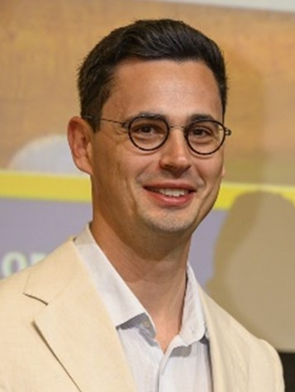
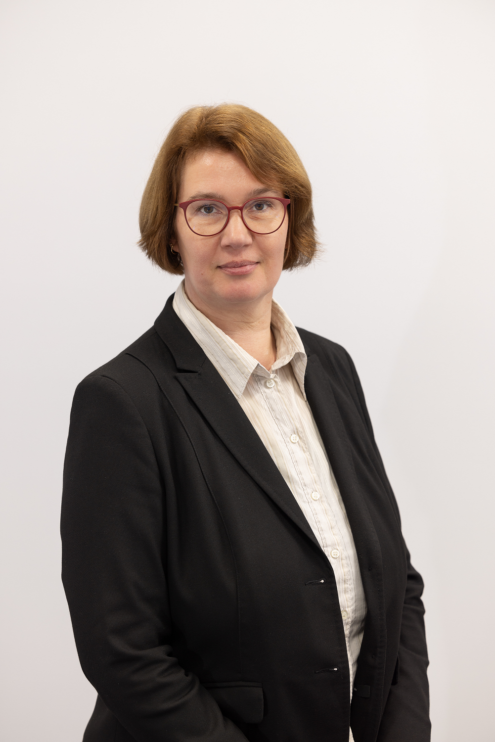
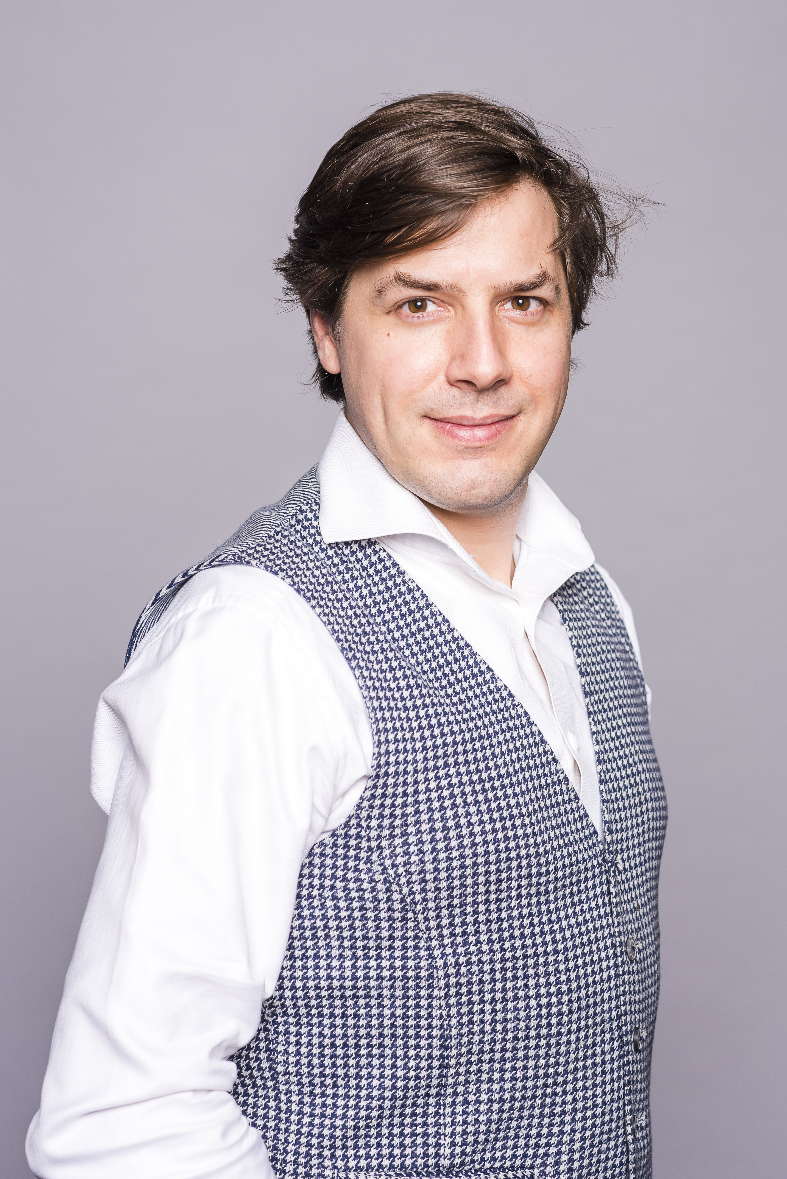
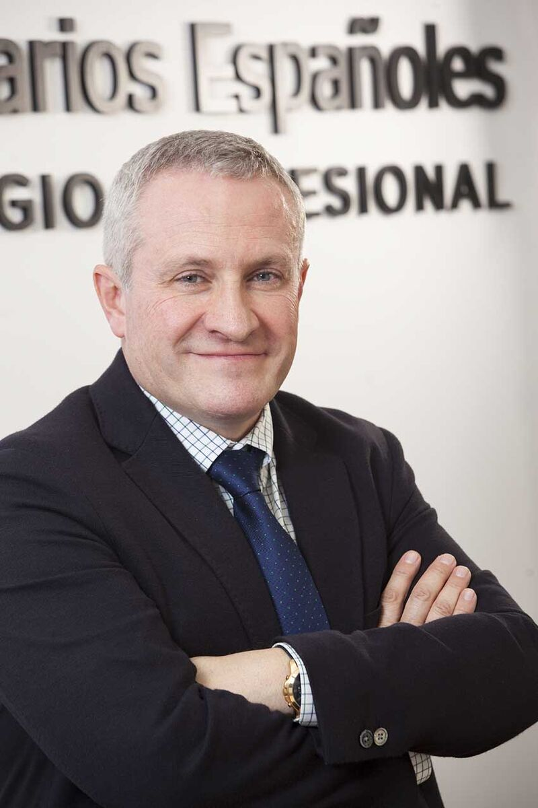
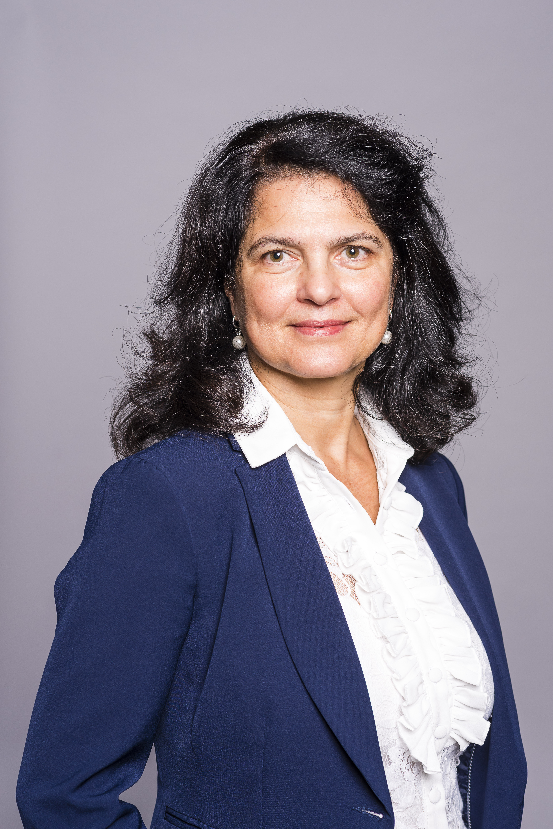
AAE Committee chairpersons
Risk Management Committee
Bogdan Tautan (Netherlands)
Elected March 2025 until GA 2026
Professionalism Committee
Birgit Kaiser (Germany)
Elected October 2024
for 3 years
Insurance Committee
Lauri Saraste(Finland)
Re-elected October 2023
for 3 years
Education Committee
Rafael Moreno Ruiz
Elected October 2024
for 3 years
Pensions Committee
Tatiana Bitunska (Bulgaria)
Re-elected October 2023
for 3 years

Slide 6







EU Stakeholders

Slide 7
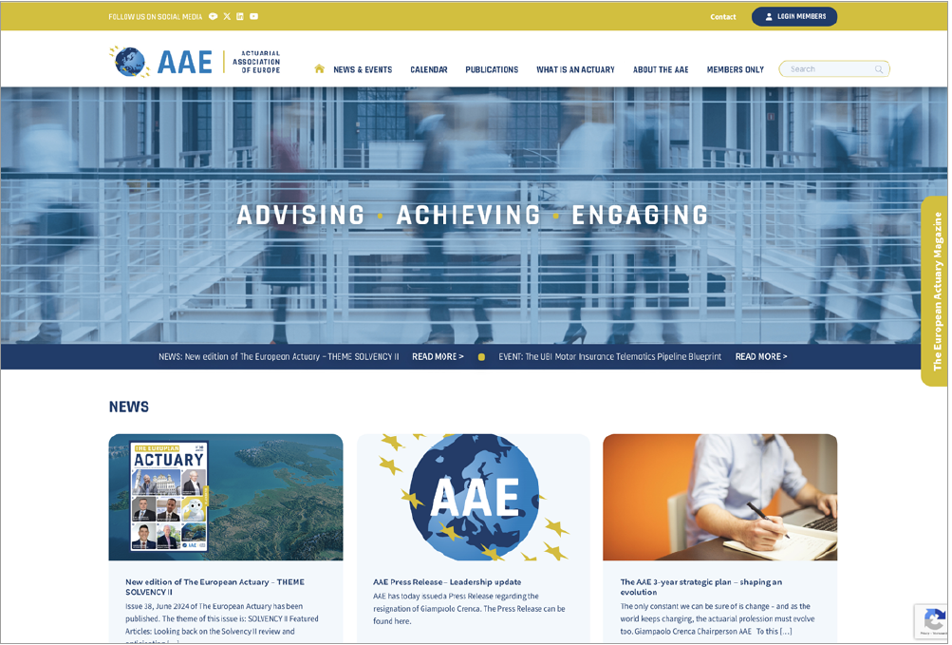
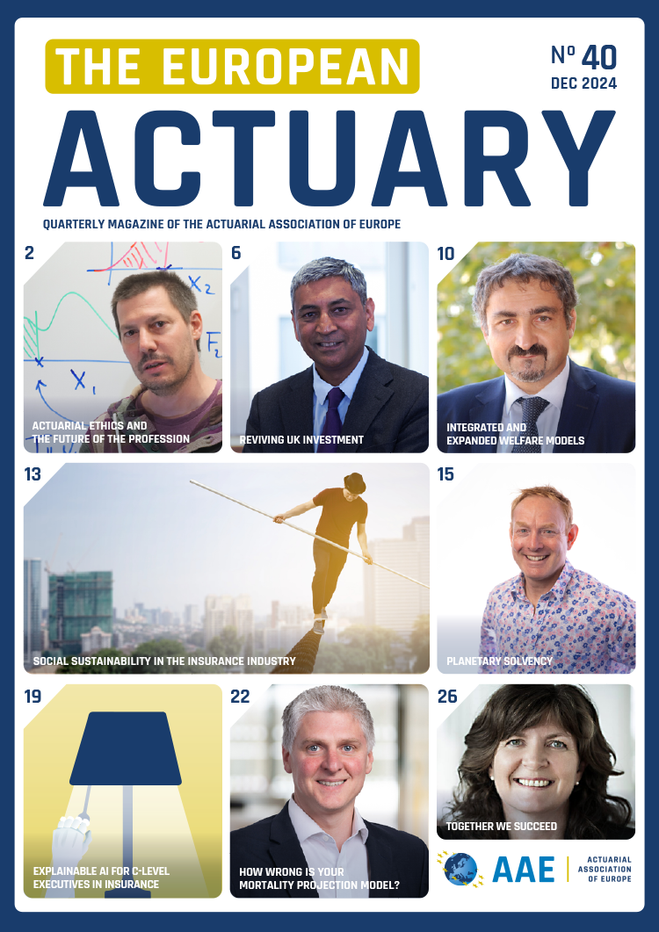
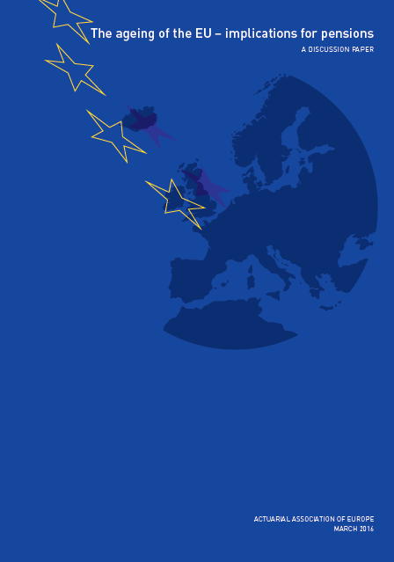

Informing (1/2)
Website
Papers and Notes
Magazine

Slide 8


Informing (2/2)
Regular newsletters
AAE Press Releases
AAE News items
LinkedIn
AAE video

Slide 9

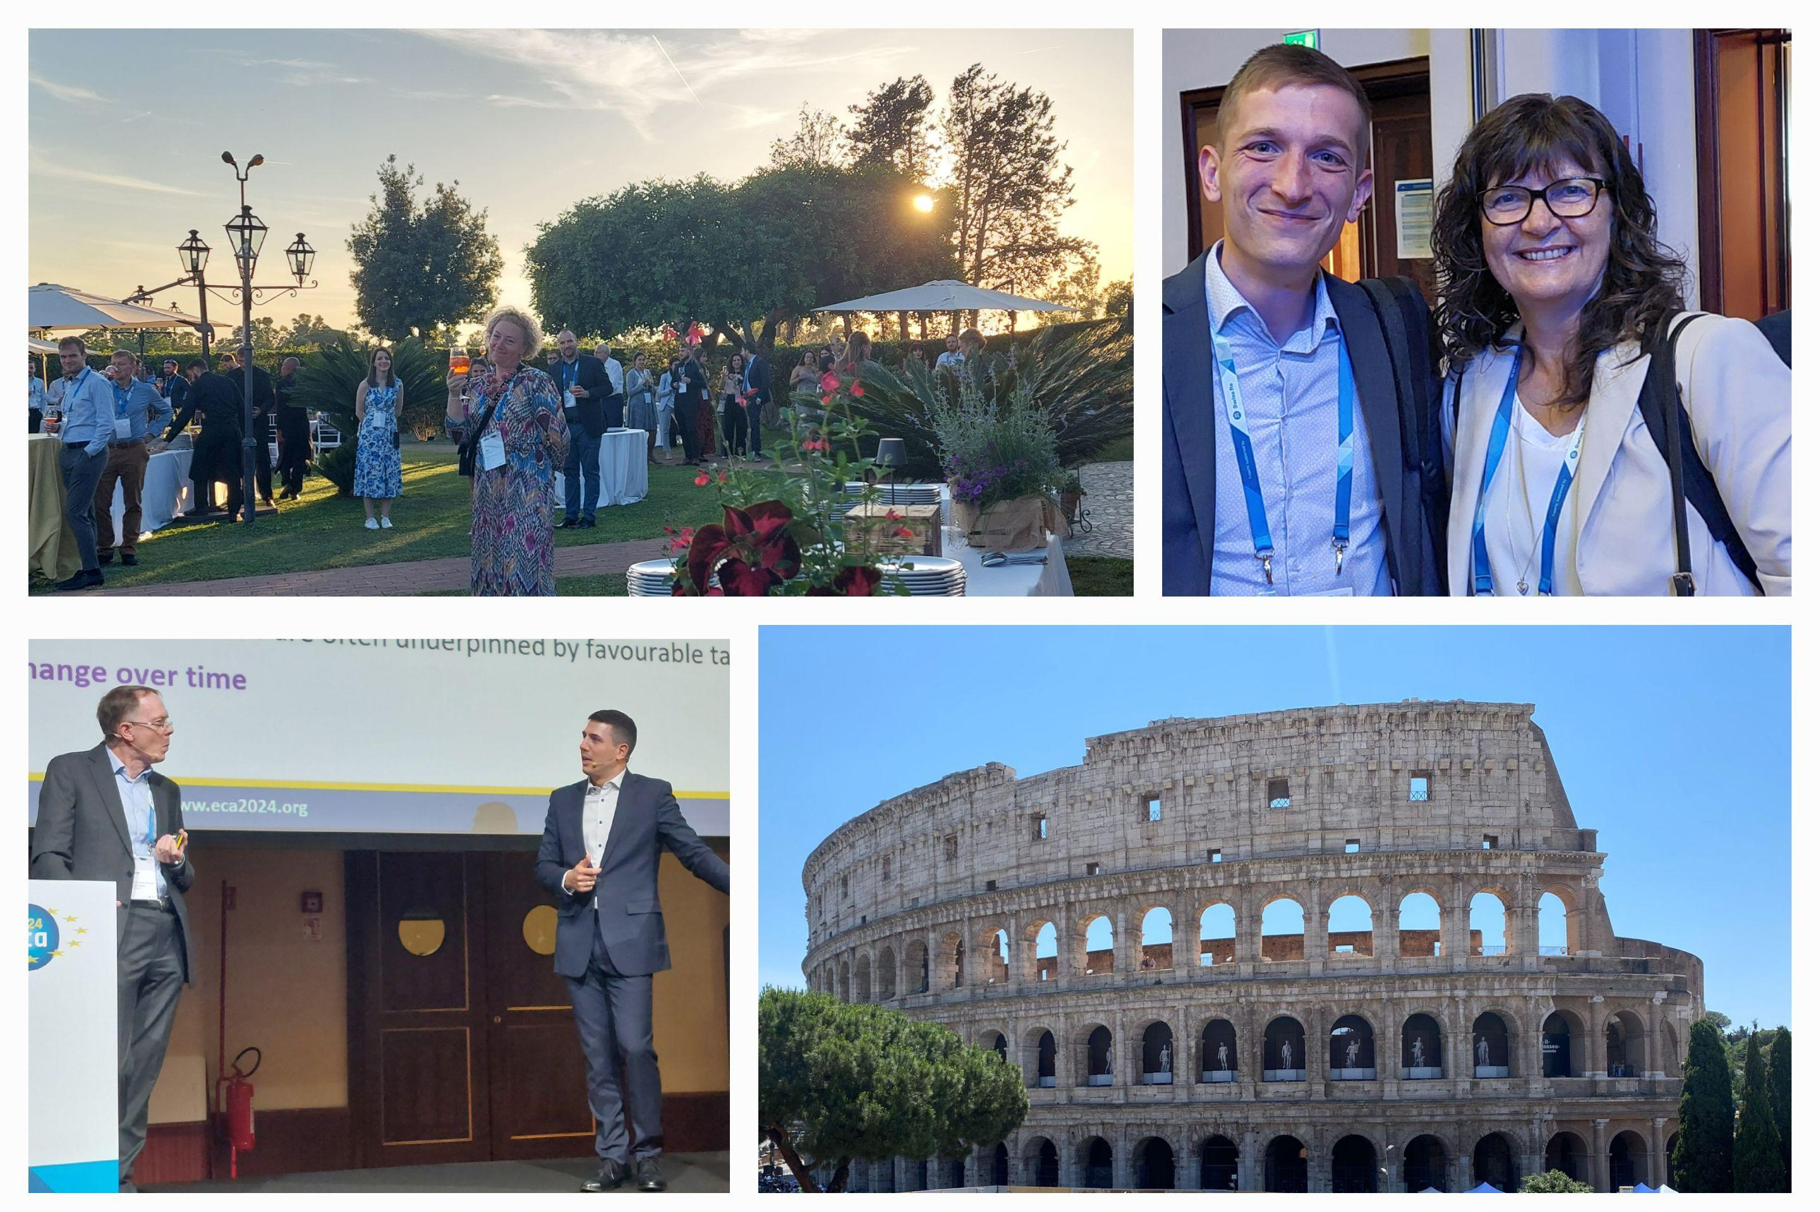


Meeting
Next EAD in 2025
Next congress in 2026

Slide 10

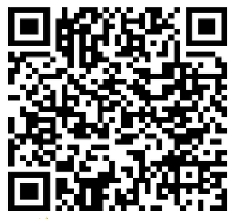
Actuarial Association of Europe
Boulevard Roi Albert II 4
B-1000 Brussels
Belgium
T: +32 2 274 06 61
E: info@actuary.eu
W: www.actuary.eu
LinkedIn
YouTube
actuview
X

